Slide 1
Condo Management System (Team 6)
Hoang Minh Khoi Pham 40162551
Michaël Gugliandolo 40213419
Jessey Thach 40210440
Mahanaim Rubin Yo 40178119
Vanessa DiPietrantonio 40189938
Ahmad Elmahallawy 40193418
Clara Gagnon 40208598
Khanh Huy Nguyen 40125396
Jean-Nicolas Sabatini-Ouellet 40207926
Mohamad Mounir Yassin 40198854

Slide 2
Main Features

Slide 3
User Profiles
Public users can create their own unique profile with profile picture, user name, contact email, phone number and password
Dashboard(s)
Each type of user will have their own dashboard to easily view all their content
Reservation System
Be able to reserve common facilities on a calendar at specific times on first come first serve basis
Notification System
Users receive notifications if their request status has been changed
Managers/Operators receive notifications that new request(s) have been assigned to them
Requests
Users can make different types of requests. Managers/Operators can change the status of the request (e.g from New to In Progress)
Property, Condo and Employee Creation
Companies can create properties, condos and also create employee accounts (by assigning different roles) for their employees and manage everything
Financial System
Add costs, generate annual reports, check operational budget
Bonus Features:
Create Forums where users can post and reply to different forums
Mobile application is accessible on both Android and IOS
Notes:
Ahmad

Slide 4
Product Demo

Slide 5
Link to the product demo video:
https://youtu.be/rFu35ZaLNT4

Slide 6
Software Architecture Document

Slide 7
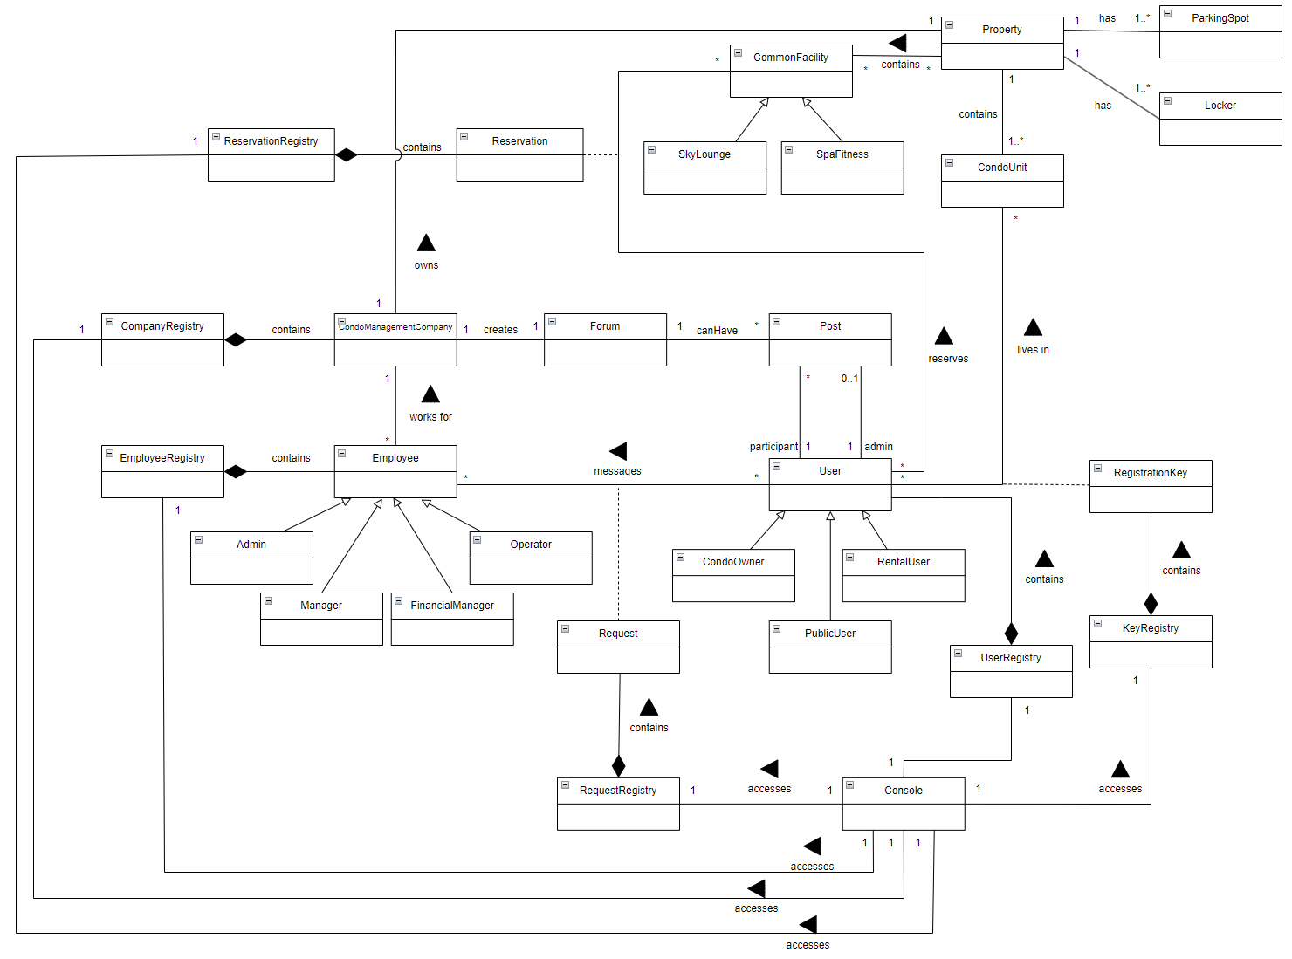
Domain Model
Notes:
Vanessa

Slide 8
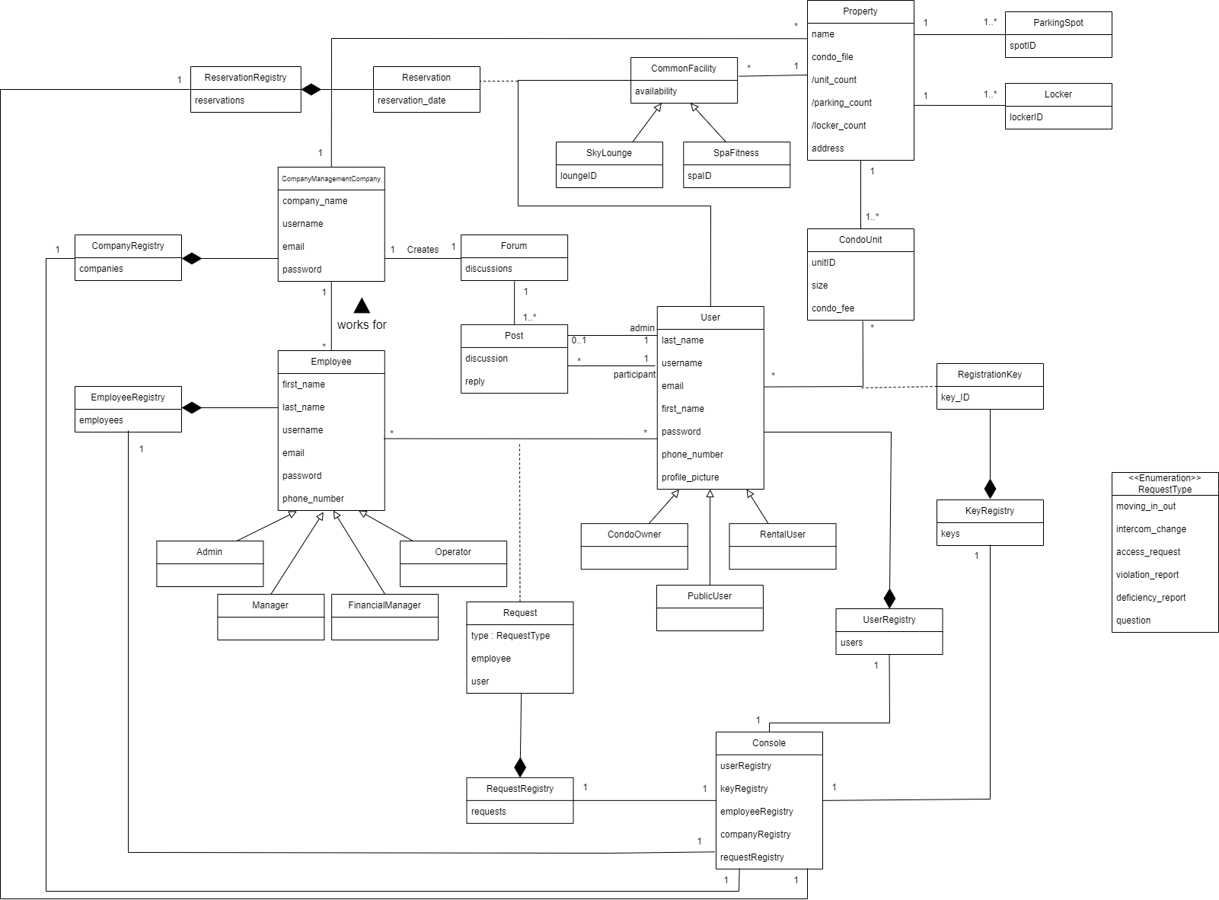
Class Diagram
Notes:
Vanessa

Slide 9
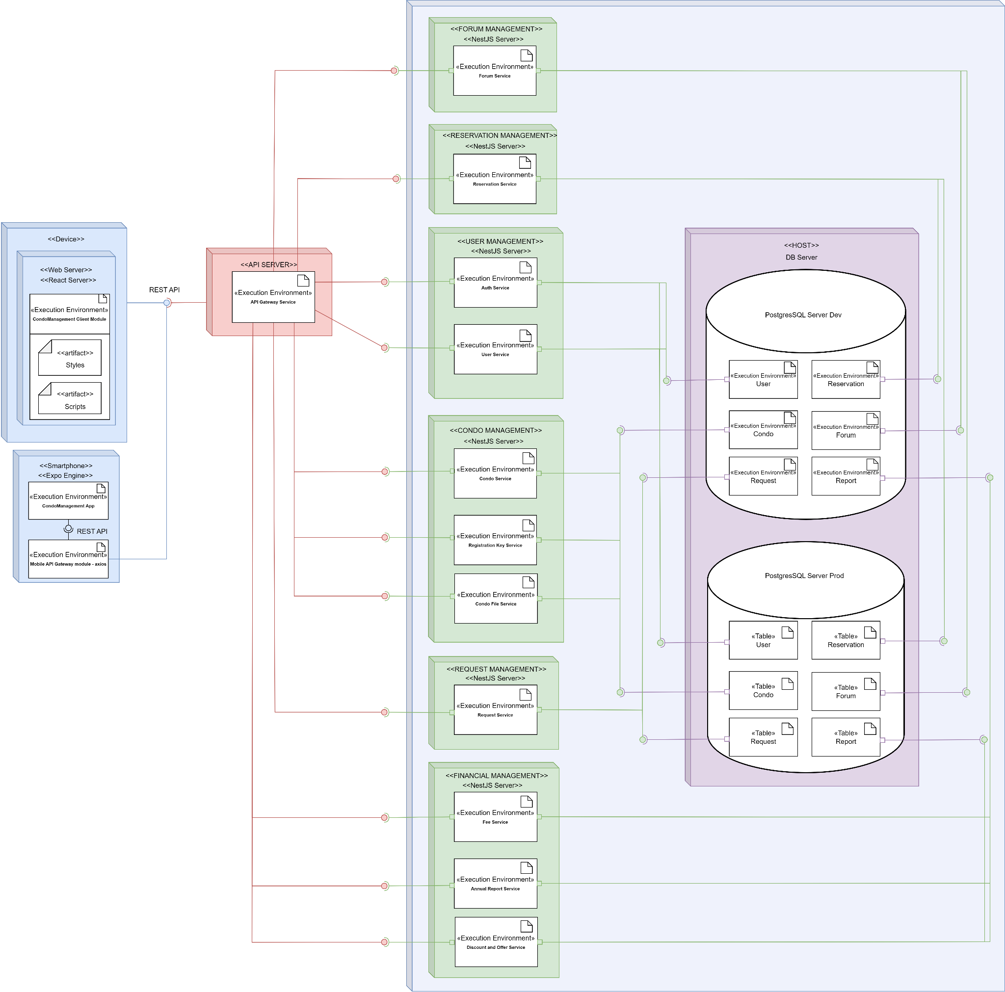
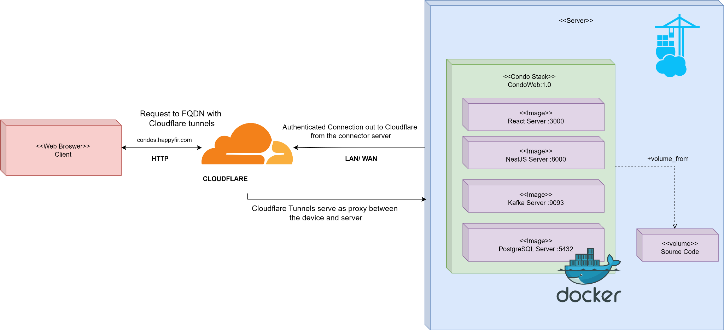
Deployment Diagrams
Notes:
Khoi

Slide 10
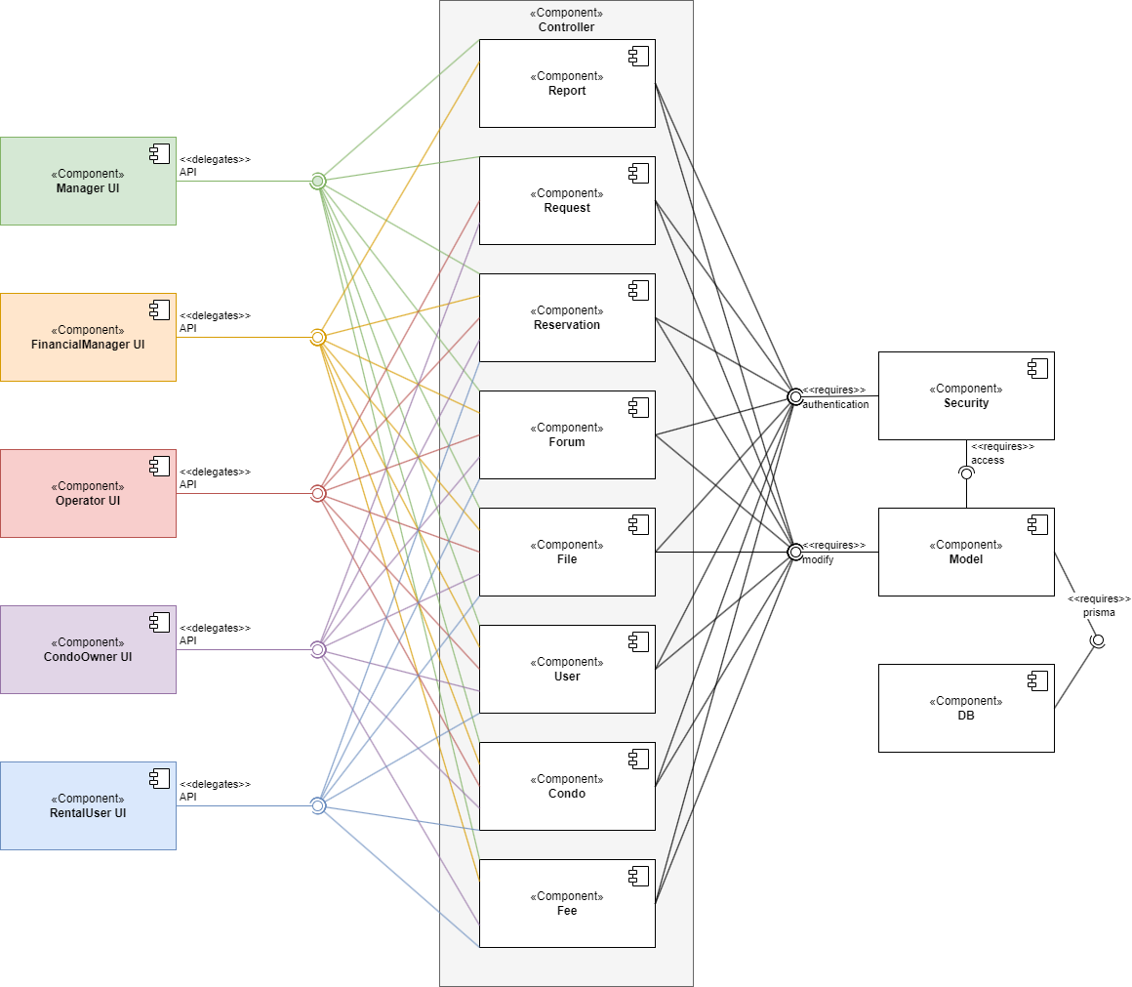
Component Diagram

Slide 11
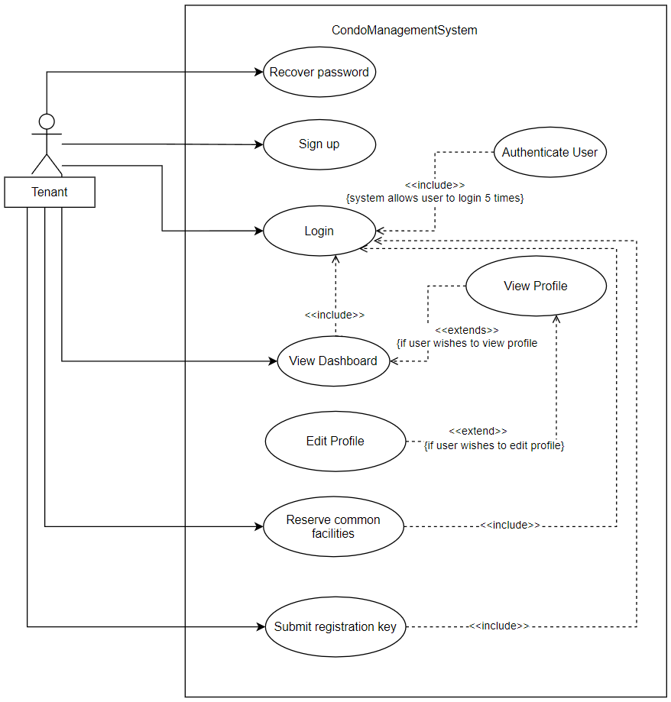
Sample Use Case Diagram
Use case diagram of the Condo Management System from a tenant’s point of view
Notes:
Huy

Slide 12
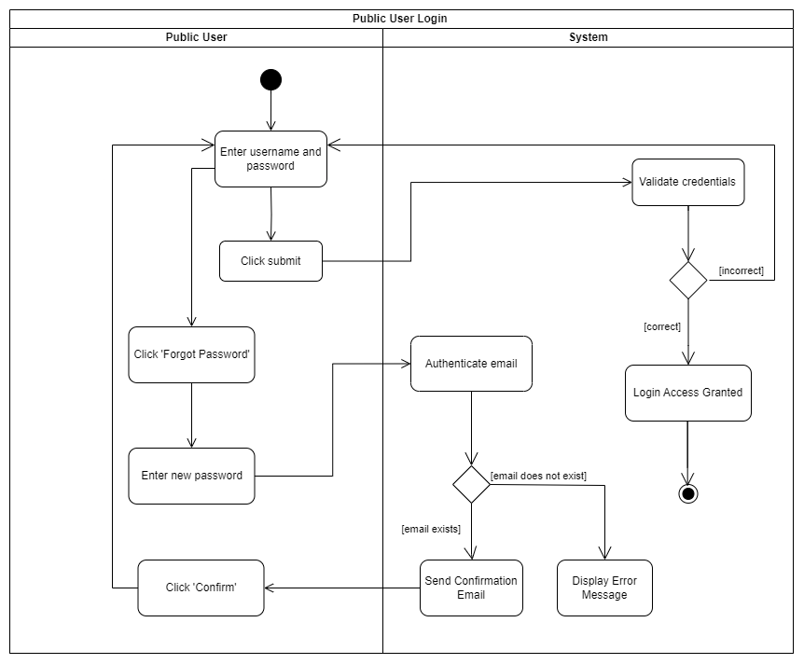
Sample Activity Diagram
Public User Login
This diagram depicts the process of actions which is taken by a public user when they would like to log in to their account.
Precondition: User is not logged in.
Notes:
Huy

Slide 13
Risk Assessment
Notes:
Clara

Slide 14
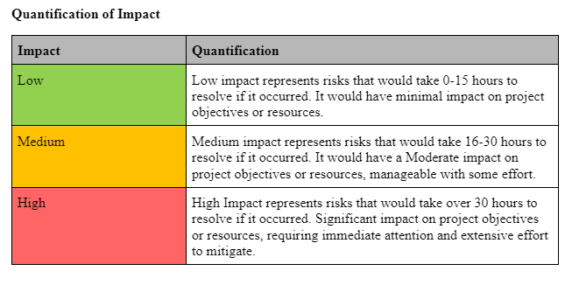
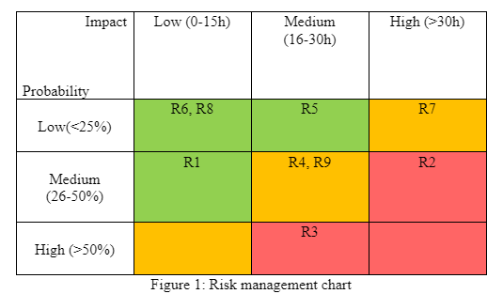
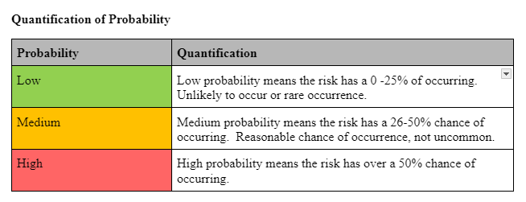
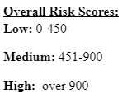
Notes:
Clara

Slide 15
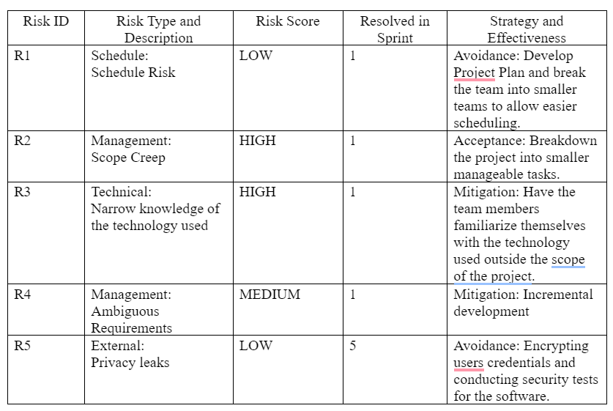
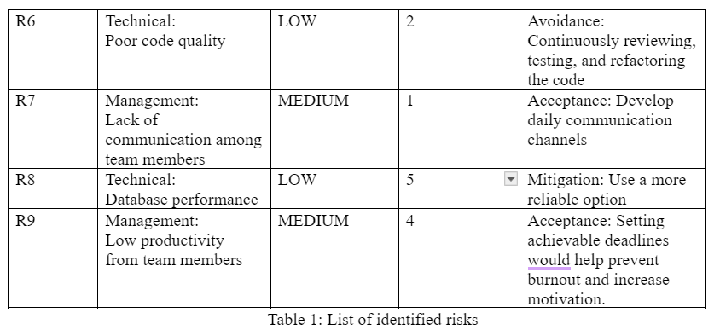
Notes:
Clara

Slide 16
Overview of Release Plan

Slide 17
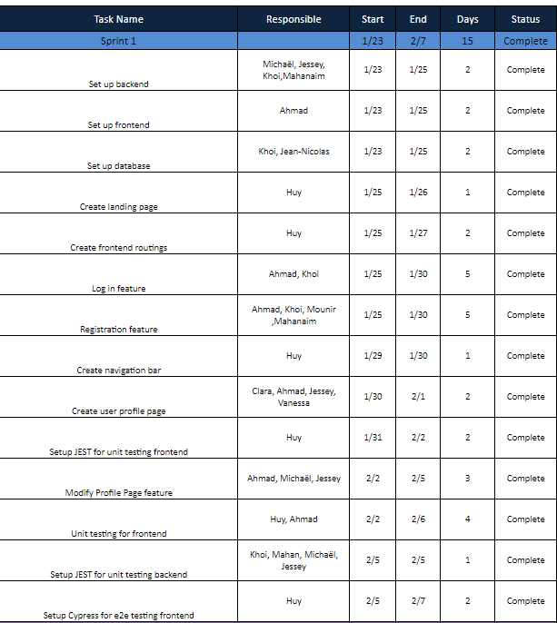
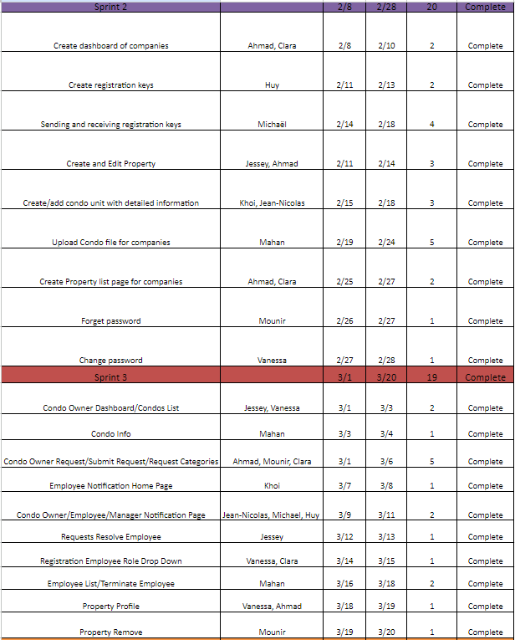
Notes:
Mounir

Slide 18
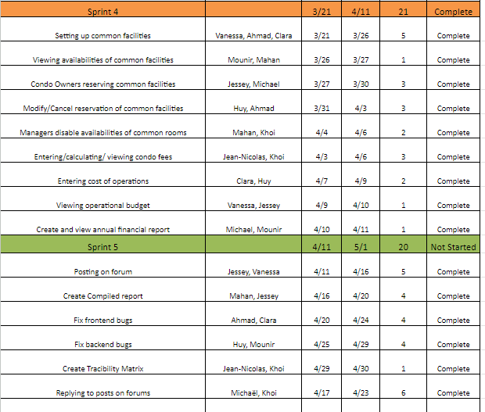
Notes:
Mounir

Slide 19
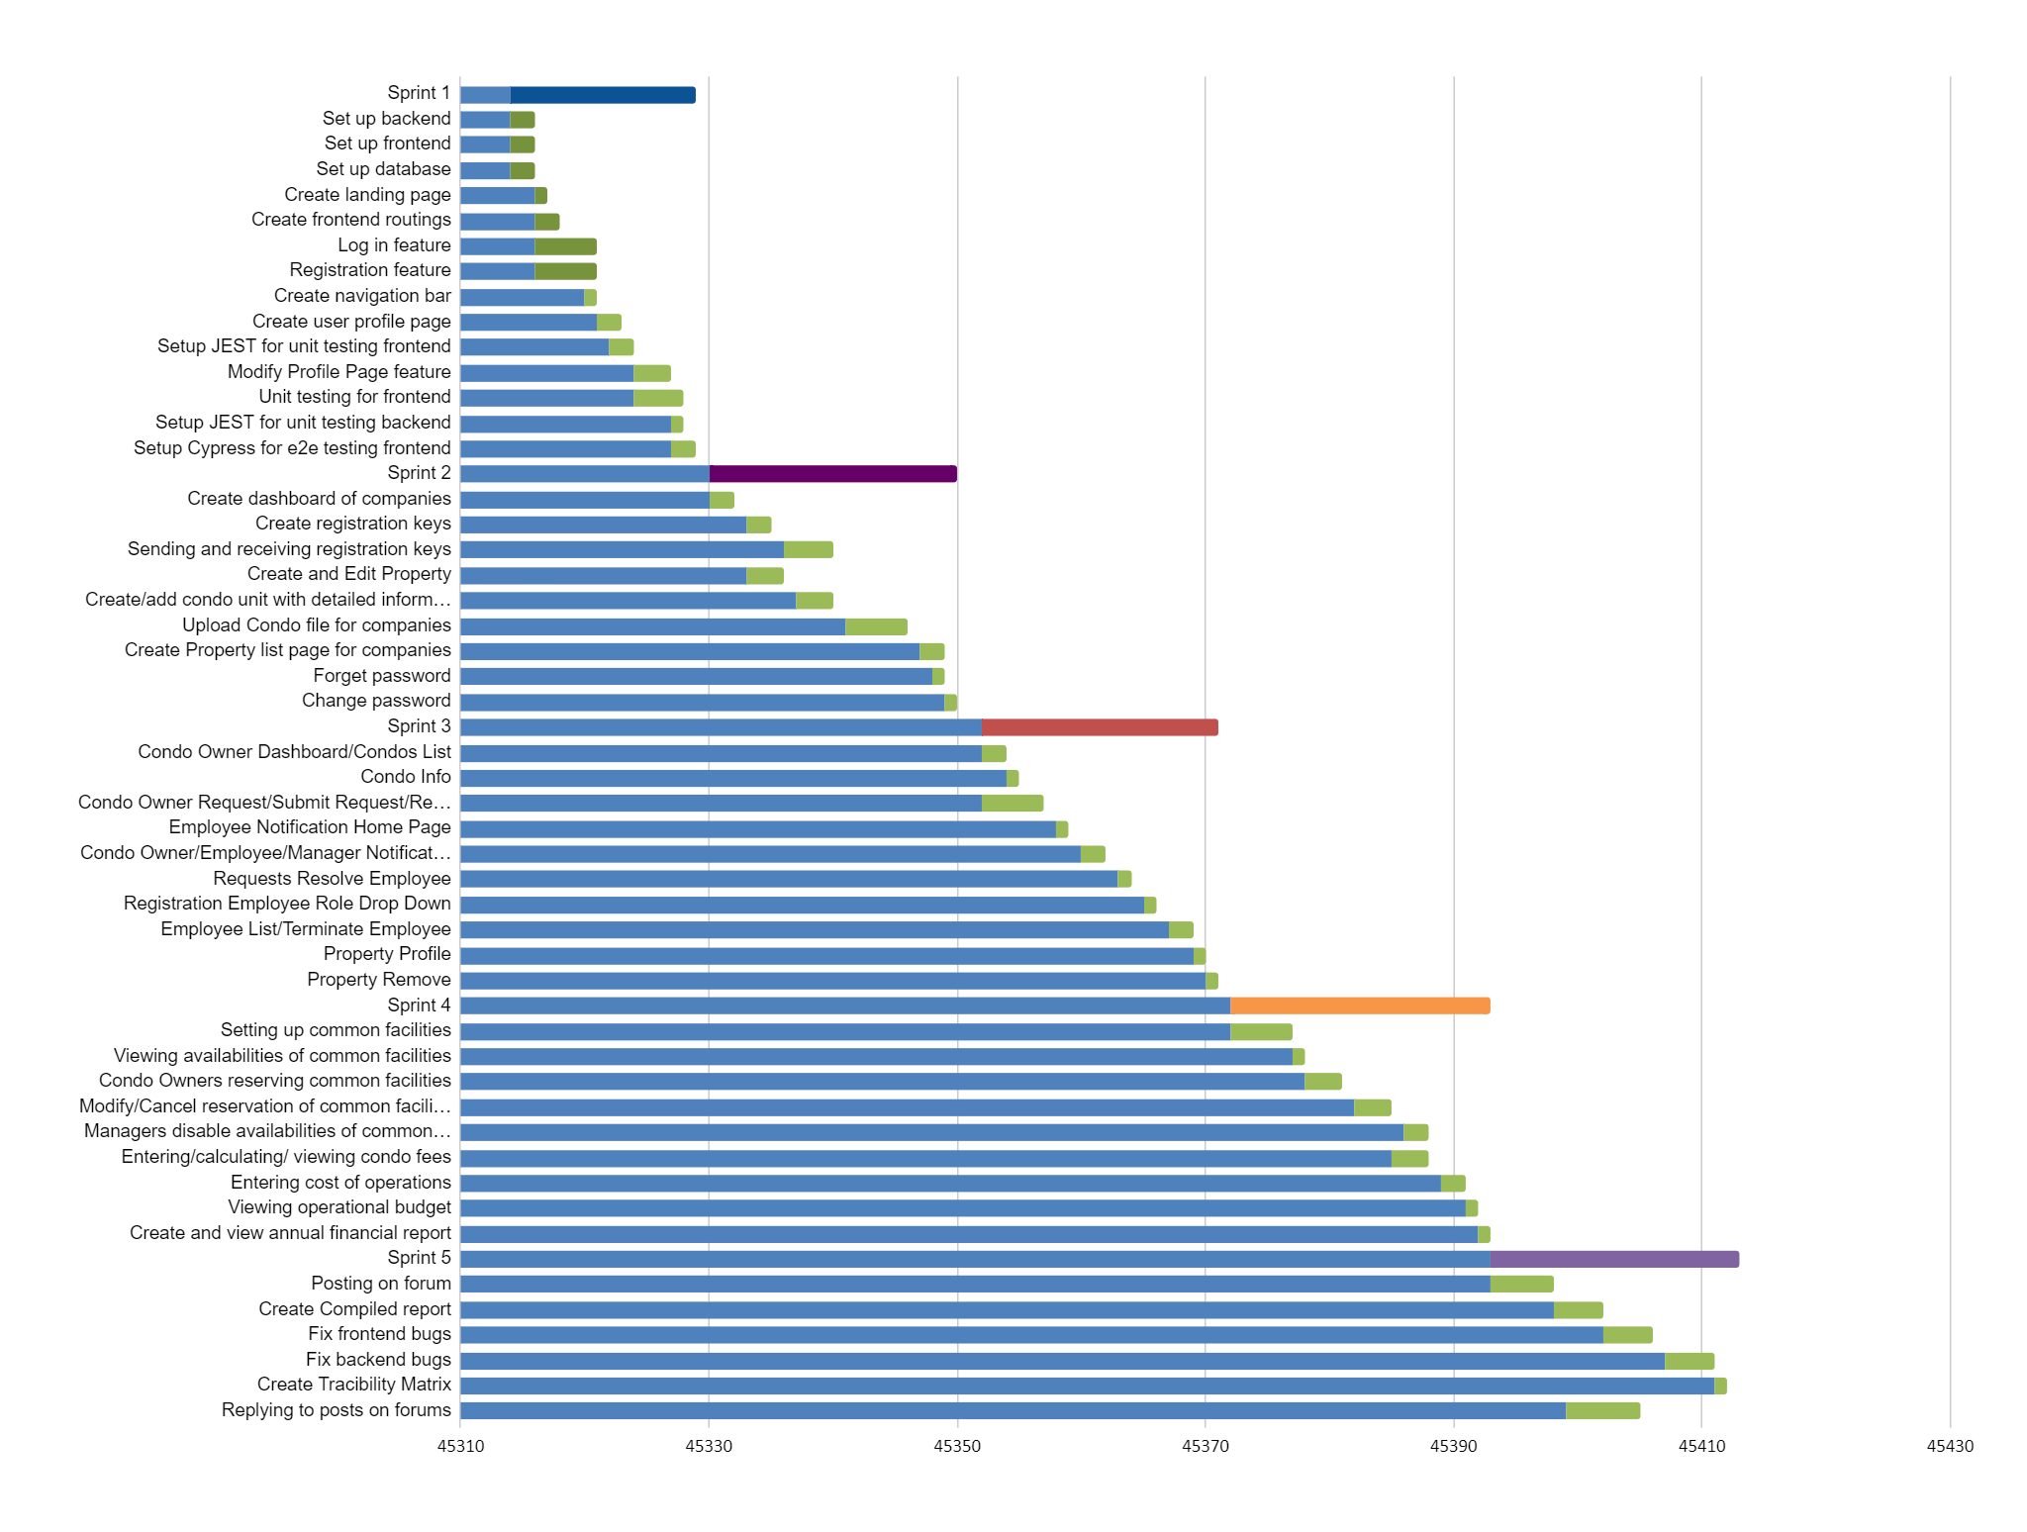
Notes:
Mounir

Slide 20
Testing Document
Notes:
Mahan

Slide 21
Testing Methods Used
1- Unit Testing
Unit testing evaluates individual components or "units" of software independently. It is a part of white box testing, an approach that examines the internal modules of the code
Library Used: JEST
2- Integration Testing
Integration testing aims to evaluate the collective performance of various system components by examining their interactions rather than scrutinizing the entire system as a single entity
Library Used: JEST
3- End to End Testing
a software testing methodology that verifies the working order of a software product in a start-to-finish process
Library Used: Cypress
Notes:
Mahan

Slide 22
Metrics
With SonarQube it is easy to keep track of our quality metrics:
Reliability
Maintainability
Security
Coverage
Duplication
Size
Complexity
Issues
Notes:
Mahan

Slide 23
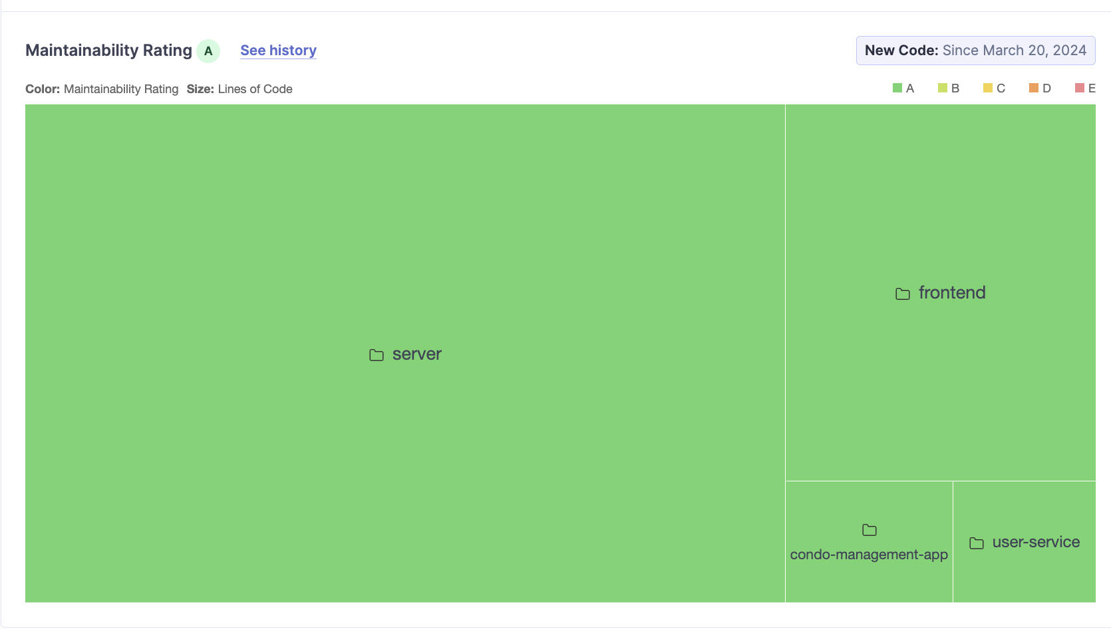
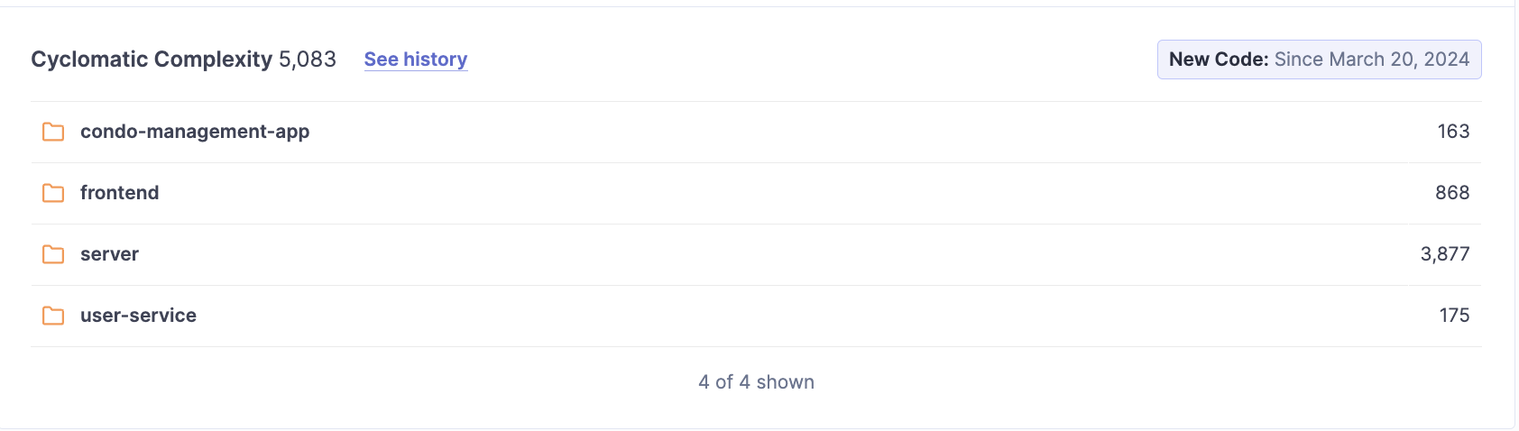
Area Map for maintainability rating
Cyclomatic Complexity analysis

Slide 24
Coverage
Software testing involves various metrics to assess the effectiveness of test cases in exercising the code. Four commonly used metrics are statement coverage, branch coverage, function coverage, and line coverage.
Notes:
Mahan

Slide 25
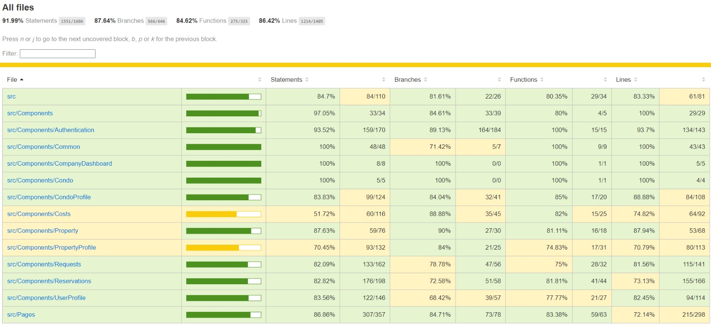
Frontend Coverage
Notes:
Mahan

Slide 26
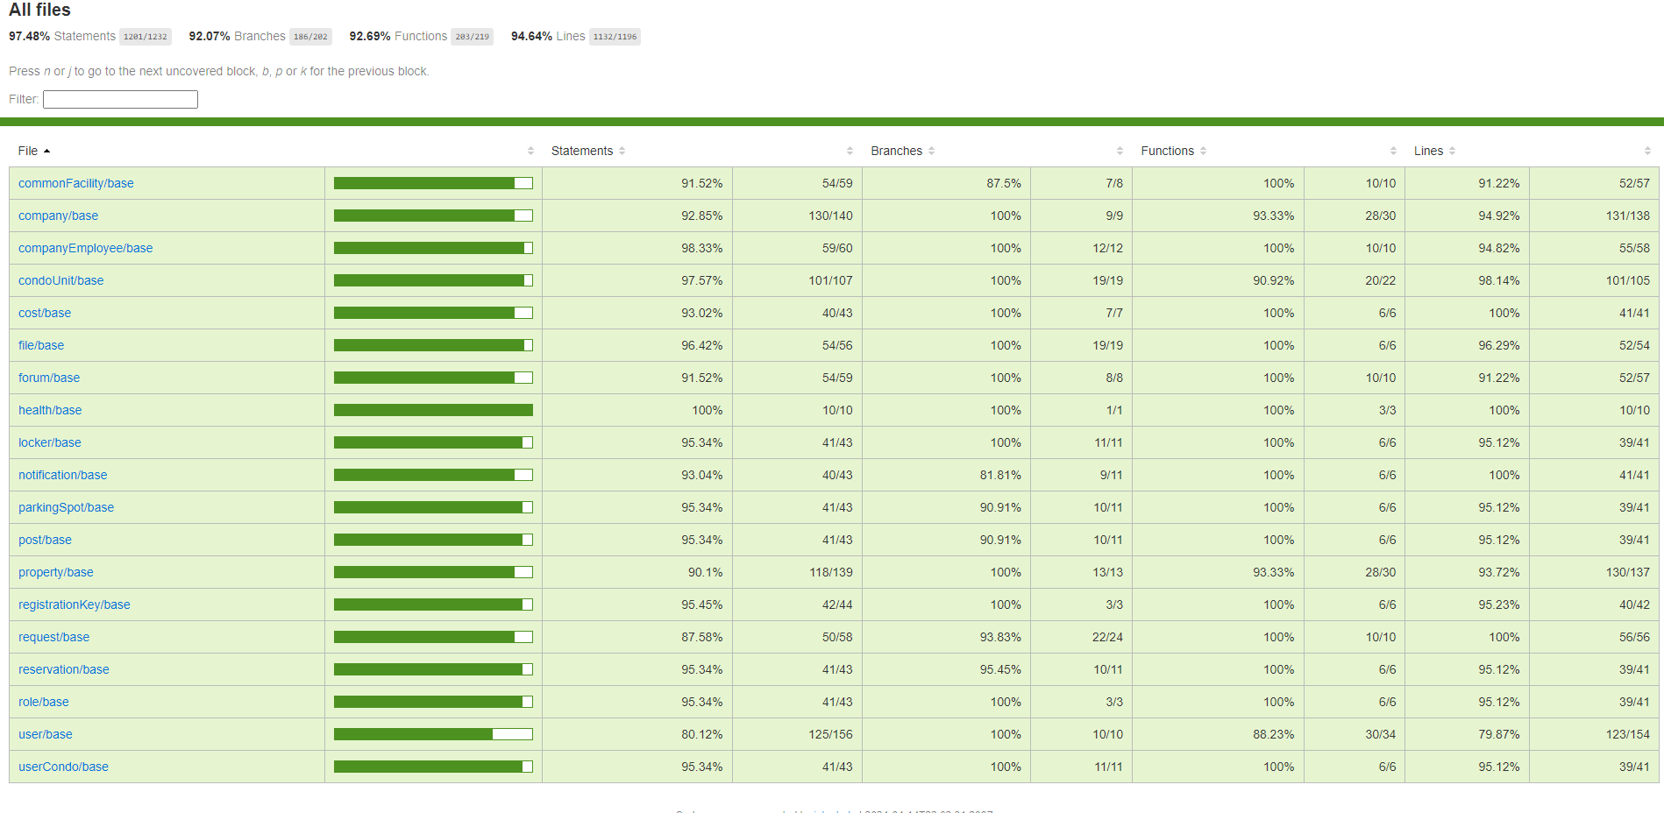
Backend Coverage
Notes:
Mahan

Slide 27
Overall Retrospective

Slide 28
What went wrong
Lack of Division of Responsibilities: Confusion arose due to undefined roles and responsibilities, impacting project progress.
Absence of Setting Deadlines: Without clear deadlines, tasks lacked urgency, causing delays.
Not Writing Tests with Tasks: Integration of testing procedures was overlooked, leading to insufficient test coverage and reliability challenges.
Inconsistent Naming Conventions: Without a standardized convention, code readability suffered, affecting collaboration.
Difficulty Organizing Meetings: Scheduling proved challenging, hindering effective communication and decision-making.
Notes:
Jean Nicholas

Slide 29
What went right
Proactive Team Collaboration: Valuing collaboration led to improved problem-solving and team dynamics.
Good Continuous Work: A disciplined approach ensured steady progress and reduced stress.
Effective Communication: Cross-functional meetings and shared learning enhanced collaboration.
Quick Decision-Making: Swift decisions minimized delays and maintained project momentum.
Notes:
Jean Nicholas

Slide 30
Lessons learnt
Clear Division of Responsibilities: Documenting roles and responsibilities to avoid confusion.
Setting and Adhering to Deadlines: Establishing clear timelines to maintain project momentum.
Prioritizing Testing: Emphasizing the importance of comprehensive testing to ensure system reliability.
Consistent Communication: Regular sync-up meetings to foster collaboration and prevent compatibility issues.
Efficient Meeting Management: Implementing tools and schedules to ensure optimal attendance and effective communication.
Notes:
Ahmad

Slide 31
UI Prototype for Web App (Not Shown in Demo)

Slide 32
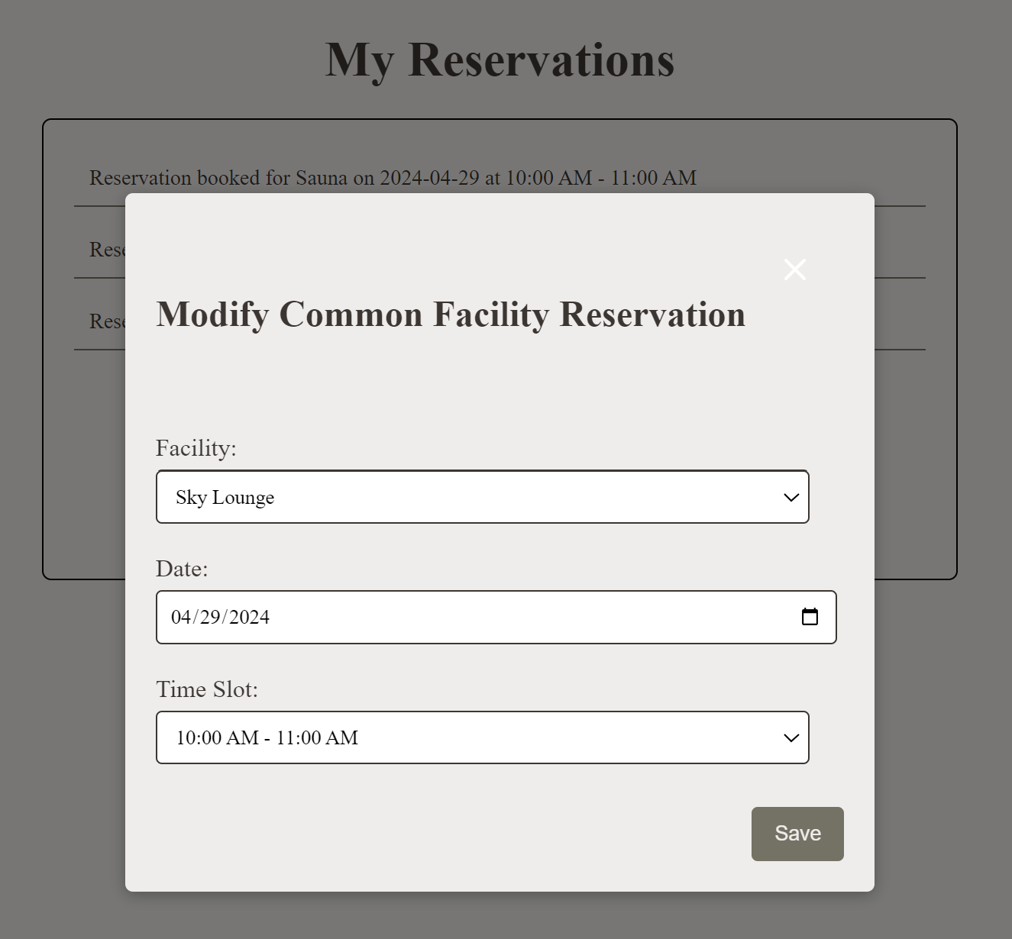
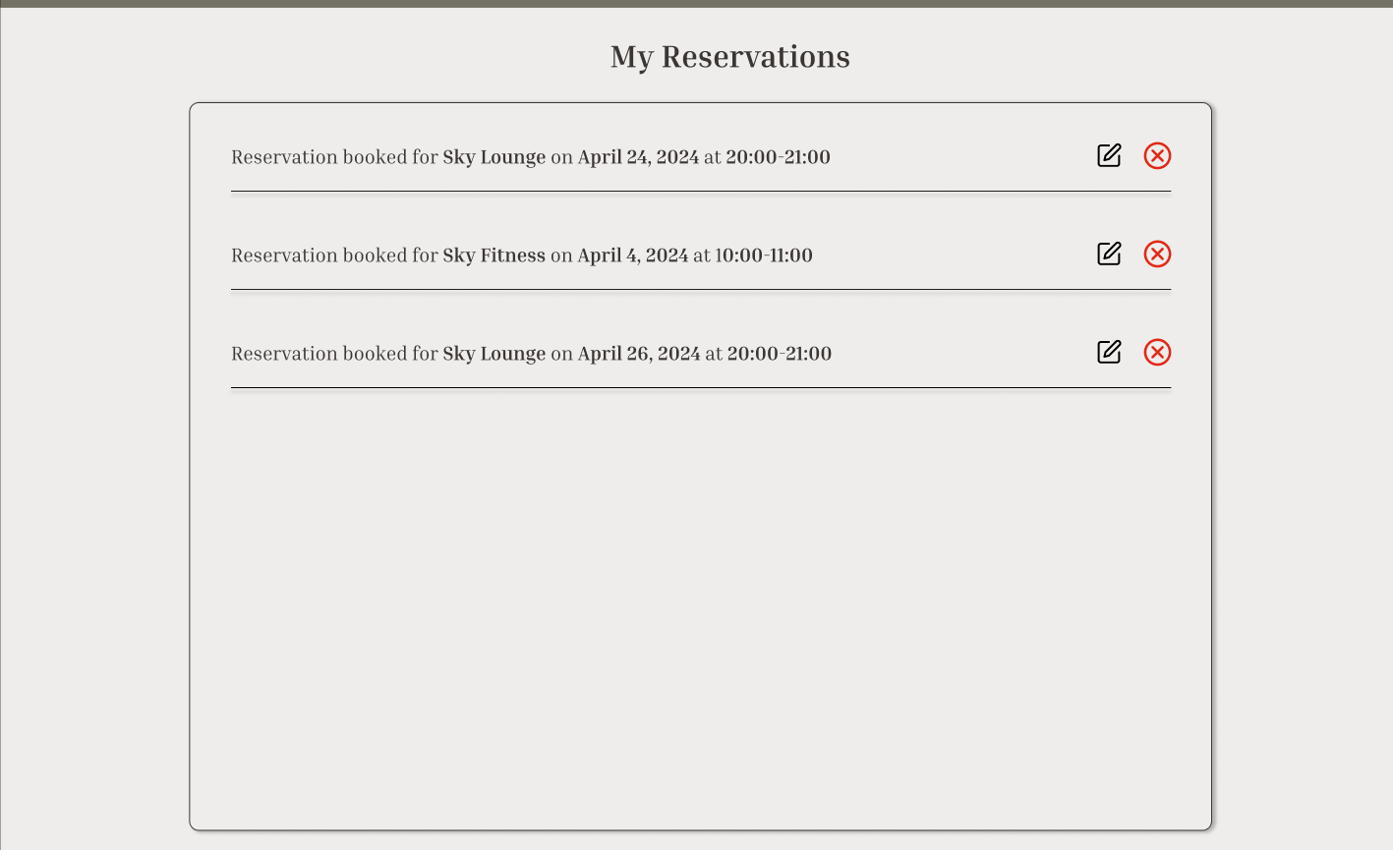
Reservations from User account (editing and removing reservations

Slide 33
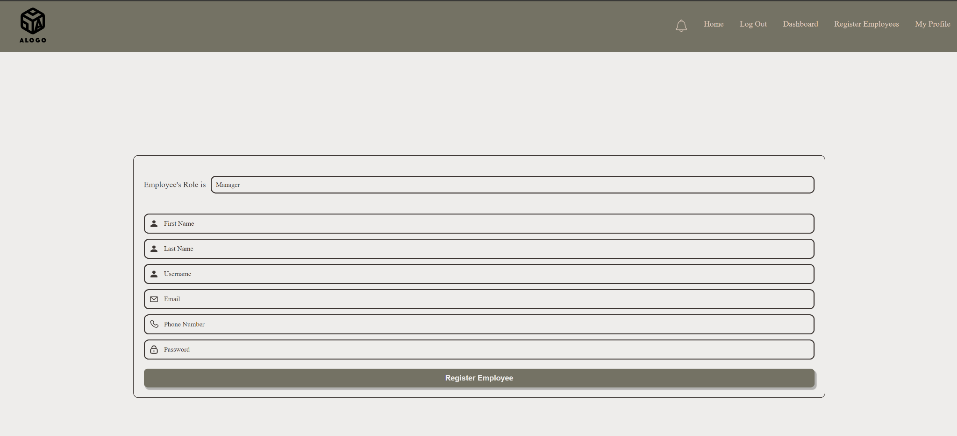
Creating an Employee By a Company (admin)
3 Employee Roles:
Manager
Financial Manager
Operator

Slide 34
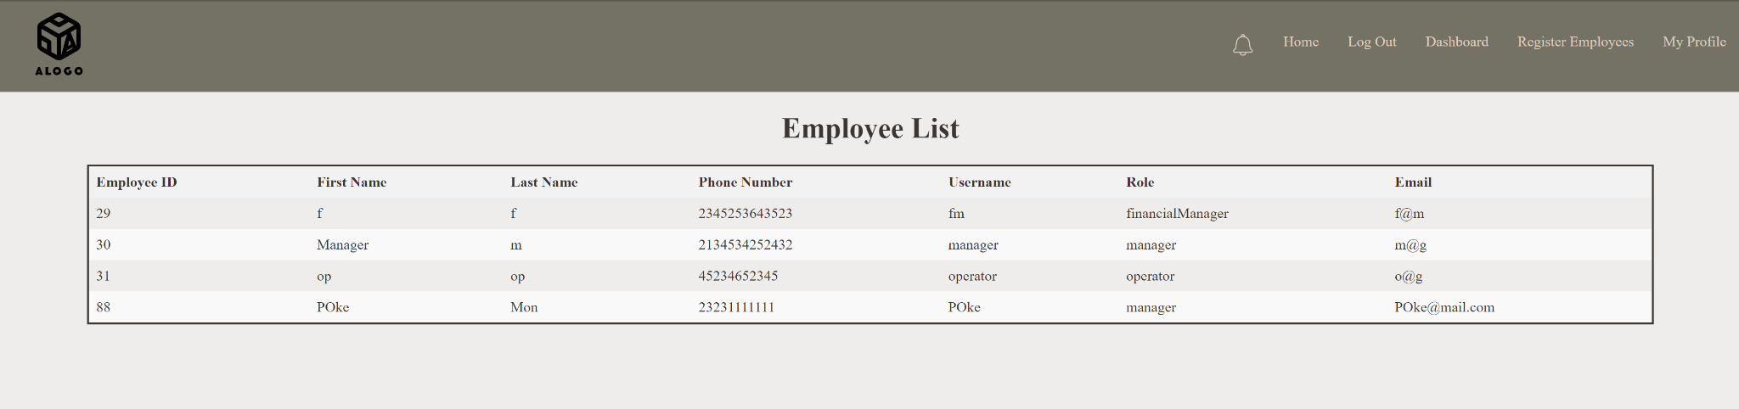
Employee List from Company’s account

Slide 35
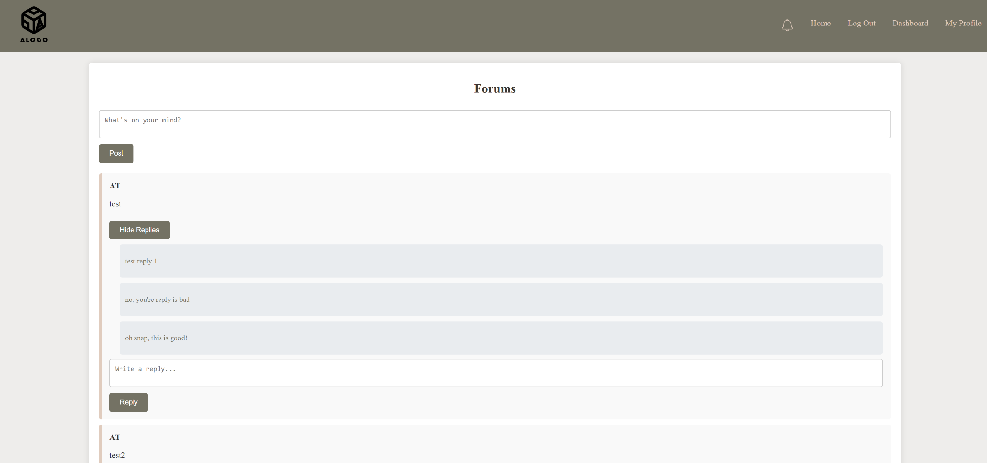
Forums Page (Bonus)
Each Post Has:
Username of the person who posted
Post content
Replies (show or hide replies) + add a reply

Slide 36
UI Prototype for Mobile App

Slide 37
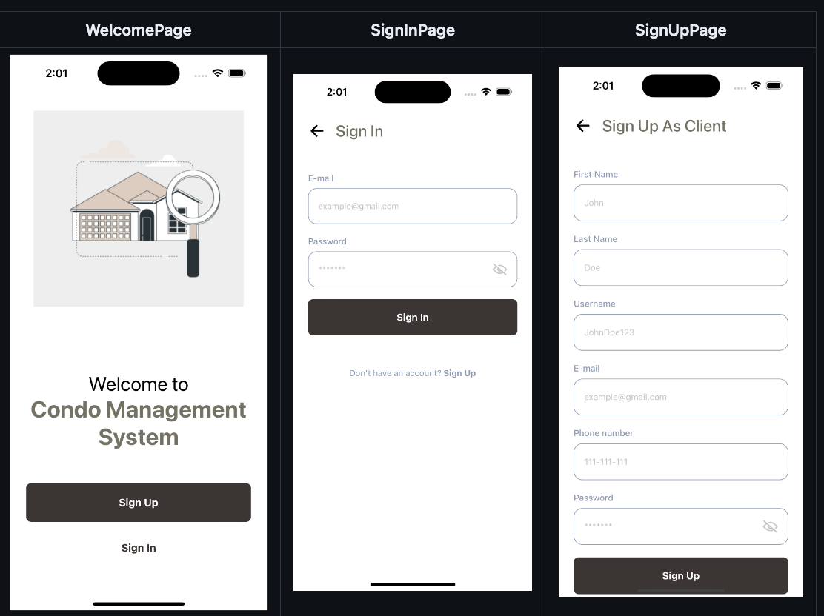

Slide 38
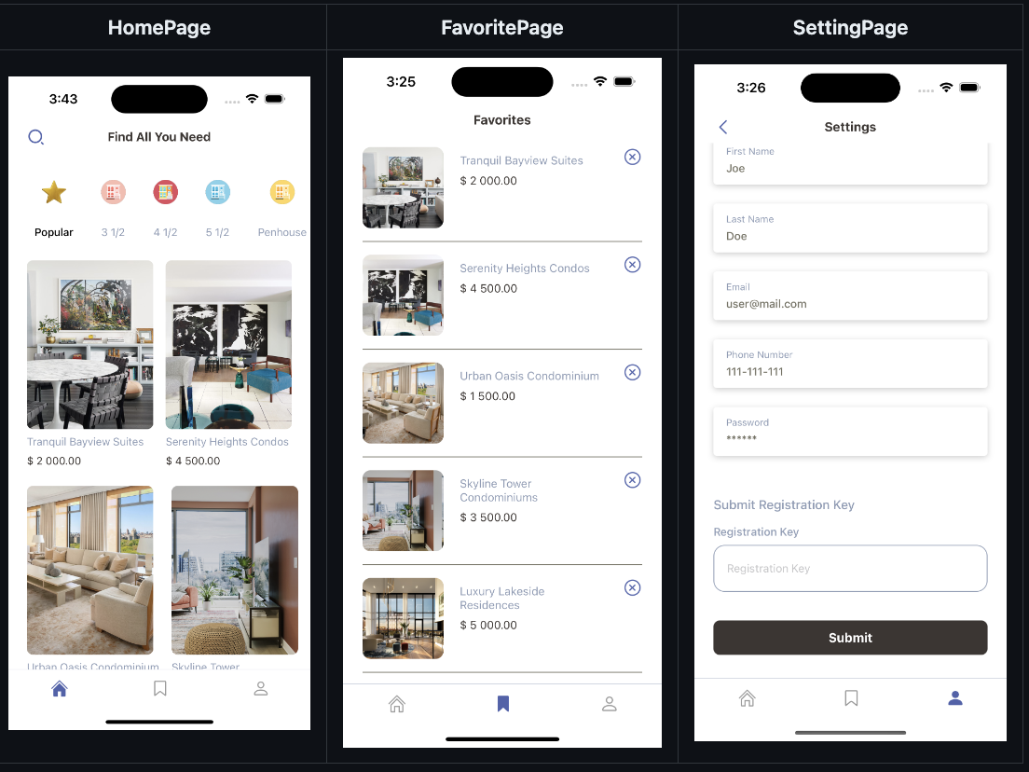
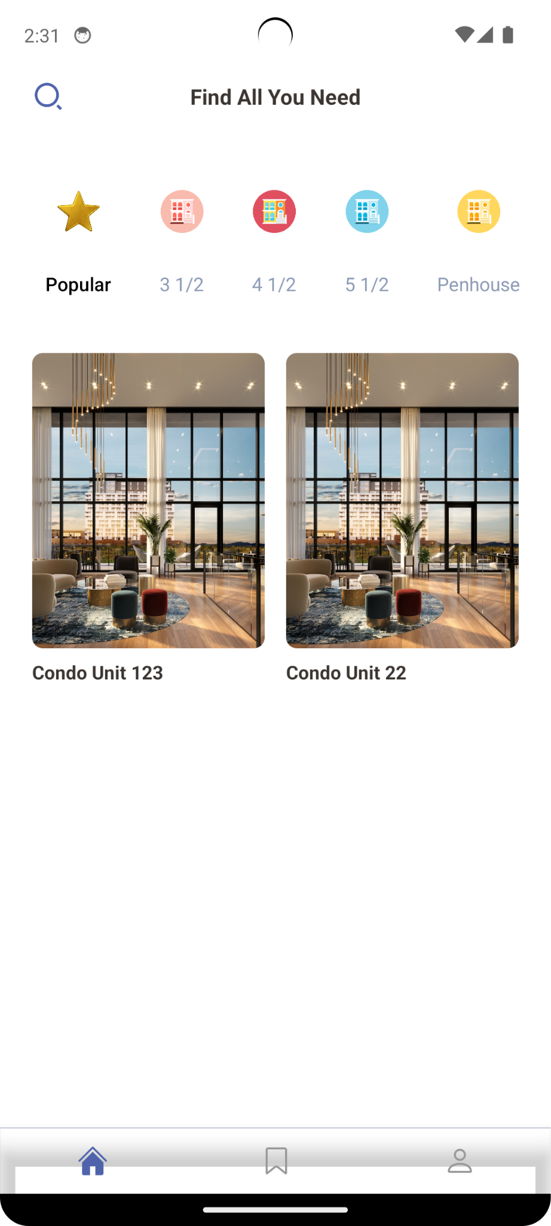

Slide 39
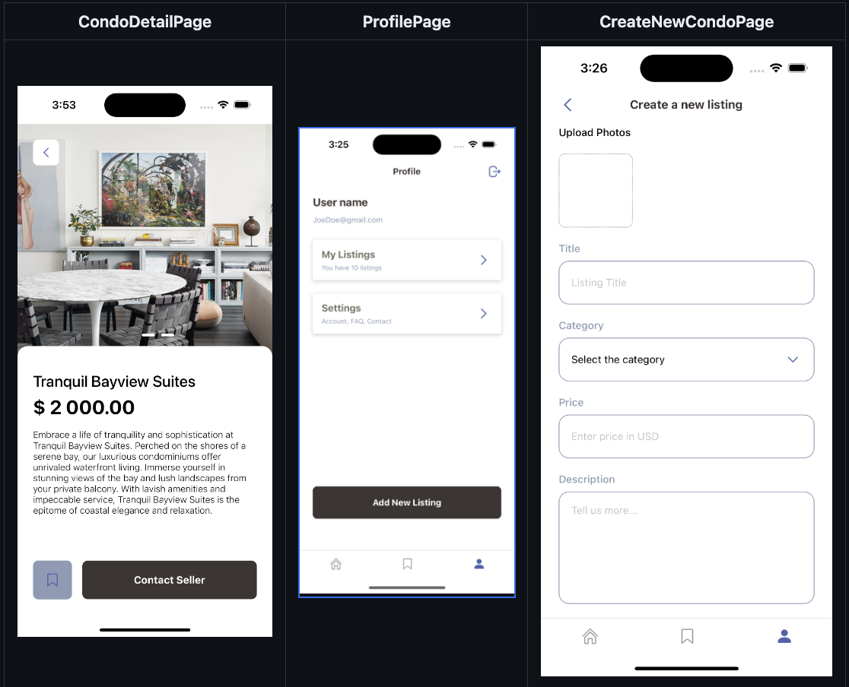
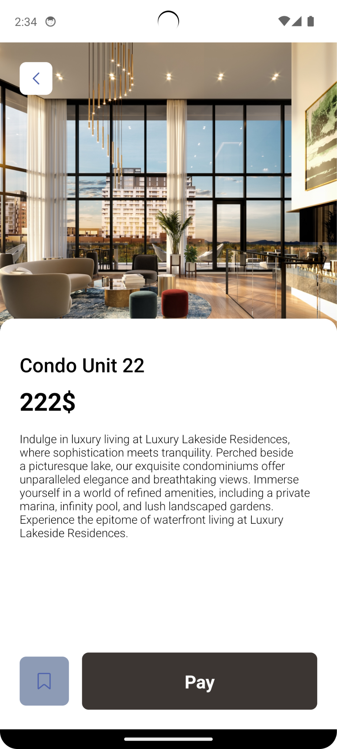

Slide 40
Thank you :)

